Slide 1
Introduction To PHP

Slide 2
Introduction to PHP
PHP (Hypertext Preprocessor) is a popular server-side scripting language used to create dynamic and interactive web applications. It works with HTML to generate web pages, handle forms, and interact with databases.

Slide 3
Why Use PHP?
✅ Easy to Learn ✅ Open Source (Free to use) ✅ Works with almost all Databases (MySQL, PostgreSQL, MongoDB) ✅ Cross-Platform (Works on Windows, Linux, Mac) ✅ Wide Community Support
How PHP Works?
The client (browser) sends a request to the server.
The server processes the PHP code.
PHP generates HTML content dynamically.
The server sends the final HTML page to the browser.

Slide 4
Basic PHP Syntax
<?php
echo "Hello, World!";
?>

Slide 5
PHP Comments & Variables
PHP Comments
Comments in PHP are used to add explanations or disable parts of the code. They are ignored during execution.
Types of Comments in PHP
1️Single-line comment (// or #)
// This is a single-line comment
# This is also a single-line comment
echo "Hello, World!";
2️Multi-line comment (/* ... */)
/*
This is a multi-line comment.
It spans multiple lines.
*/
echo "Welcome to PHP!";

Slide 6
PHP Variables
Rules for PHP Variables
✅ Must start with $ (e.g., $name, $age). ✅ Must start with a letter or underscore (_), but not a number. ✅ Can contain letters, numbers, and underscores ($user_name, $userAge). ✅ PHP variables are case-sensitive ($name and $Name are different).

Slide 7
Declaring Variables
<?php
$name = "John"; // String
$age = 25; // Integer
$height = 5.8; // Float
$isStudent = true; // Boolean
echo "Name: $name, Age: $age, Height: $height, Student: $isStudent";
?>

Slide 8
Variable Scope in PHP
Local Variables
Declared inside a function and can’t be accessed outside
<?php
function myFunction() {
$message = "Hello"; // Local variable
echo $message;
}
myFunction();
// echo $message; ❌ ERROR! $message is not accessible outside the function.
?>

Slide 9
Global Variables
Declared outside a function and accessible anywhere using global.
<?php
$site = "PHP World"; // Global variable
function showSite() {
global $site; // Accessing global variable
echo $site;
}
showSite();
?>

Slide 10
Static Variables
Retains its value even after the function exits.
<?php
function counter() {
static $count = 0; // Static variable
$count++;
echo $count . " ";
}
counter(); // Output: 1
counter(); // Output: 2
counter(); // Output: 3
?>

Slide 11
Variable Interpolation
PHP automatically replaces variable names inside double quotes ("").
$name = "Alice";
echo "Hello, $name"; // ✅ Output: Hello, Alice
echo 'Hello, $name'; // ❌ Output: Hello, $name (does not interpolate)

Slide 12
Constants in PHP
A constant is like a variable, but its value cannot be changed.
<?php
define("SITE_NAME", "MyWebsite"); // Defining a constant
echo SITE_NAME; // Output: MyWebsite
?>

Slide 13
PHP echo Statement
The echo statement in PHP is used to output data to the browser. It is one of the most commonly used functions for displaying text, variables, HTML, or any other output in PHP.
Basic Syntax of echo
<?php
echo "Hello, World!";
?>

Slide 14
Features of echo
✅ Can output multiple values (comma-separated). ✅ Faster than print (since it doesn’t return a value). ✅ Does not require parentheses (()), but can be used with them
echo with Variables
<?php
$name = "Alice";
$age = 25;
echo "My name is $name and I am $age years old.";
?>

Slide 15
Using echo with HTML
You can embed HTML inside echo to generate dynamic content.
<?php
echo "<h1>Welcome to My Website</h1>";
echo "<p>This is a paragraph.</p>";
?>

Slide 16
Single vs Double Quotes in echo
Double quotes ("") allow variable interpolation (expanding variables inside the string). Single quotes ('') treat everything as a string.
<?php
$name = "Alice";
echo "Hello, $name"; // ✅ Output: Hello, Alice
echo 'Hello, $name'; // ❌ Output: Hello, $name (does not expand the variable)
?>

Slide 17
Using echo with Concatenation (.)
If you use single quotes, or want to combine text and variables, use concatenation (. operator).
<?php
$name = "Bob";
echo 'Hello, ' . $name . '!'; // ✅ Output: Hello, Bob!
?>

Slide 18
echo with HTML Attributes
You can dynamically add values inside HTML attributes.
<?php
$color = "blue";
echo "<p style='color: $color;'>This is a blue paragraph.</p>";
?>

Slide 19
PHP Data Types
In PHP, data types define the kind of values a variable can hold. PHP is a loosely typed language, meaning you don’t need to specify the data type—it is automatically determined based on the assigned value.

Slide 20
PHP Supports 8 Primary Data Types
PHP data types can be categorized into: 1️Scalar Types (Single values)
String
Integer
Float (Double)
Boolean
2️Compound Types (Multiple values)
Array
Object
3️Special Types
NULL
Resource

Slide 21
<?php
// String
$stringVar = "Hello, PHP!";
var_dump($stringVar); // Output: string(12) "Hello, PHP!"
// Integer
$intVar = 100;
var_dump($intVar); // Output: int(100)
// Float
$floatVar = 99.99;
var_dump($floatVar); // Output: float(99.99)
// Boolean
$boolVar = true;
var_dump($boolVar); // Output: bool(true)
// Array
$arrayVar = array("Apple", "Banana", "Cherry");
var_dump($arrayVar); // Output: array(3) { [0]=> string(5) "Apple" [1]=> string(6) "Banana" [2]=> string(6) "Cherry" }
// NULL
$nullVar = null;
var_dump($nullVar); // Output: NULL
?>

Slide 22
PHP Strings & Important String Functions
A string in PHP is a sequence of characters enclosed in single quotes (') or double quotes (").
<?php
$string1 = "Hello, World!";
$string2 = 'PHP is awesome!';
echo $string1;
?>
strlen() – Get String Length
Returns the number of characters (including spaces) in a string.

Slide 23
<?php
$text = "Hello PHP!";
echo strlen($text); // Output: 10
?>
str_word_count() – Count Words in a String
Counts the number of words in a string.
<?php
$text = "PHP is a great language!";
echo str_word_count($text); // Output: 5
?>

Slide 24
strrev() – Reverse a String
Reverses the given string.
<?php
echo strrev("Hello"); // Output: olleH
?>
strpos() – Find Position of a Substring
Finds the position of the first occurrence of a substring in a string.
<?php
$text = "Hello PHP!";
echo strpos($text, "PHP"); // Output: 6
?>

Slide 25
str_replace() – Replace a Substring
eplaces all occurrences of a substring with another substring.
<?php
$text = "I love JavaScript!";
echo str_replace("JavaScript", "PHP", $text);
// Output: I love PHP!
?>

Slide 26
strtoupper() & strtolower() – Change Case
strtoupper() → Converts string to uppercase. strtolower() → Converts string to lowercase.
<?php
$text = "Hello World!";
echo strtoupper($text); // Output: HELLO WORLD!
echo strtolower($text); // Output: hello world!
?>

Slide 27
PHP Numbers
PHP supports two main types of numbers: 1️Integer – Whole numbers (e.g., 10, -50, 1000) 2️Float (Double) – Decimal numbers (e.g., 3.14, -0.99, 2.5e3)

Slide 28
PHP Number Functions
PHP provides built-in functions to work with numbers.
Function | Description | Example
is_int() | Checks if a variable is an integer | is_int(10) → true
is_float() | Checks if a variable is a float | is_float(3.14) → true
is_numeric() | Checks if a variable is a number or a numeric string | is_numeric("100") → true
round() | Rounds a float to the nearest integer | round(3.6) → 4
ceil() | Rounds up a number | ceil(3.1) → 4
floor() | Rounds down a number | floor(3.9) → 3
abs() | Returns the absolute value | abs(-10) → 10
sqrt() | Returns the square root | sqrt(25) → 5
pow() | Raises a number to a power | pow(2, 3) → 8
rand() | Generates a random number | rand(1, 100) → (random number)

Slide 29
Example using Number Functions
<?php
$num = -25.75;
echo abs($num); // Output: 25.75
echo round(4.6); // Output: 5
echo ceil(4.2); // Output: 5
echo floor(4.8); // Output: 4
echo sqrt(16); // Output: 4
?>

Slide 30
PHP Type Casting (Converting Data Types)
PHP automatically converts variables between types when needed (type juggling). However, you can manually convert (cast) a variable to a specific type.
Type Casting Syntax
To cast a variable, use (type) before the value.
$var = "100";
$intVar = (int) $var; // Convert to integer

Slide 31
<?php
$num = "100.99";
// Convert to Integer
$intVal = (int) $num;
echo $intVal; // Output: 100
// Convert to Float
$floatVal = (float) $num;
echo $floatVal; // Output: 100.99
// Convert to Boolean
$boolVal = (bool) $num;
echo $boolVal; // Output: 1 (true)
// Convert to String
$stringVal = (string) 123;
echo $stringVal; // Output: "123"
?>

Slide 32
PHP Operators
Operators are used to perform operations on variables and values in PHP.
Types of Operators in PHP
🔹 1️Arithmetic Operators (Perform mathematical operations)

Slide 33
Arithmetic Operator
Operator | Name | Example | Output
+ | Addition | 5 + 3 | 8
- | Subtraction | 5 - 3 | 2
* | Multiplication | 5 * 3 | 15
/ | Division | 10 / 2 | 5
% | Modulus (Remainder) | 10 % 3 | 1
** | Exponentiation | 2 ** 3 | 8

Slide 34
Assignment Operators (Assign values to variables)
Operator | Example | Equivalent To
= | $a = 10 | $a = 10
+= | $a += 5 | $a = $a + 5
-= | $a -= 5 | $a = $a - 5
*= | $a *= 5 | $a = $a * 5
/= | $a /= 5 | $a = $a / 5
%= | $a %= 5 | $a = $a % 5

Slide 35
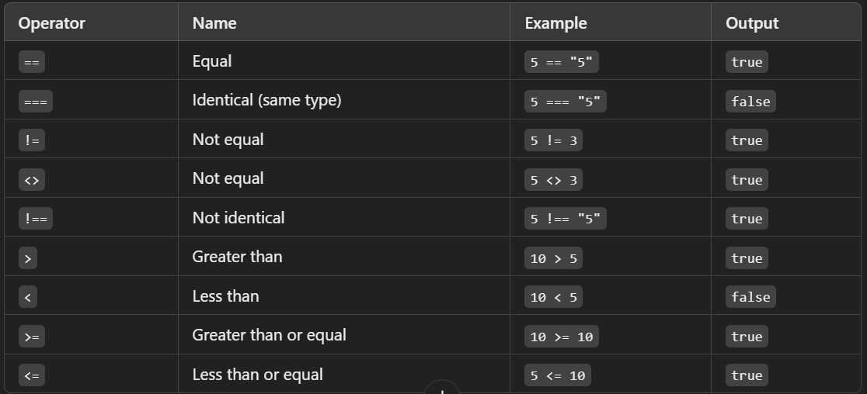

Slide 36
Logical Operators (Used for conditions)
Operator | Symbol | Description | Example (T/F) | Result
AND | && | Both must be true | T && F | F
OR | || | At least one true | T || F | T
NOT | ! | Inverts the value | !T | F
XOR | xor | Only one true | T xor F | T

Slide 37
Increment & Decrement Operators (Increase or decrease values)
Operator | Name | Example | Output
++$a | Pre-increment | $a = 5; ++$a; | 6
$a++ | Post-increment | $a = 5; $a++; | 6 (returns 5 first)
--$a | Pre-decrement | $a = 5; --$a; | 4
$a-- | Post-decrement | $a = 5; $a--; | 4 (returns 5 first)

Slide 38
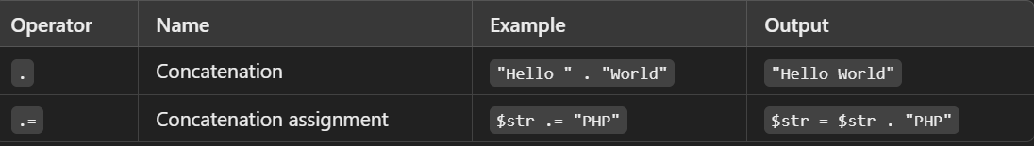
String Operators (Used for string manipulation)

Slide 39
Types of Conditions in PHP
if Statement
Executes code if the condition is true.
<?php
$age = 20;
if ($age >= 18) {
echo "You are an adult.";
}
?>

Slide 40
if...else Statement
Executes one block if true, another if false
<?php
$age = 16;
if ($age >= 18) {
echo "You can vote.";
} else {
echo "You cannot vote.";
}
?>

Slide 41
if...elseif...else Statement
Checks multiple conditions.
<?php
$score = 85;
if ($score >= 90) {
echo "Grade: A";
} elseif ($score >= 80) {
echo "Grade: B";
} else {
echo "Grade: C";
}
?>

Slide 42
Ternary Operator (? :) – Short If-Else
<?php
$age = 18;
echo ($age >= 18) ? "Adult" : "Minor";
?>

Slide 43
PHP Loops
Loops in PHP repeat a block of code until a condition is met.
for Loop – Used when you know the number of iterations
<?php
for ($i = 1; $i <= 5; $i++) {
echo "Number: $i <br>";
}
?>

Slide 44
while Loop – Runs while condition is true
<?php
$i = 1;
while ($i <= 5) {
echo "Number: $i <br>";
$i++;
}
?>

Slide 45
do...while Loop – Runs at least once, even if false
<?php
$i = 6;
do {
echo "Number: $i <br>";
$i++;
} while ($i <= 5);
?>

Slide 46
Creating a Function
Use function keyword to define a function.
<?php
function greet() {
echo "Hello, World!";
}
greet(); // Calling the function
?>

Slide 47
Function with Parameters
Parameters allow passing values to a function.
<?php
function greetUser($name) {
echo "Hello, $name!";
}
greetUser("Alice");
?>

Slide 48
Function with Return Value
Use return to send back a value.
<?php
function add($a, $b) {
return $a + $b;
}
$result = add(5, 3);
echo "Sum: $result";
?>

Slide 49
Anonymous (Lambda) Functions
Used for short, inline functions.
<?php
$greet = function($name) {
return "Hello, $name!";
};
echo $greet("Bob");
?>

Slide 50
PHP Arrays
An array in PHP is a collection of multiple values stored in a single variable.
Indexed Array (Numeric Keys)
Elements are accessed using numeric indexes (starting from 0).
<?php
$colors = ["Red", "Green", "Blue"];
echo $colors[0]; // Output: Red
?>

Slide 51
Associative Array (Named Keys)
Each key is a string instead of a number.
<?php
$student = ["name" => "John", "age" => 20, "grade" => "A"];
echo $student["name"]; // Output: John
?>

Slide 52
Multidimensional Array (Array Inside Array)
Used to store complex data.
<?php
$students = [
["Alice", 22, "A"],
["Bob", 21, "B"]
];
echo $students[0][0]; // Output: Alice
?>

Slide 53
Looping Through Arrays
Using foreach for Indexed Array
<?php
$colors = ["Red", "Green", "Blue"];
foreach ($colors as $color) {
echo "$color <br>";
}
?>

Slide 54
Using foreach for Associative Array
<?php
$student = ["name" => "John", "age" => 20, "grade" => "A"];
foreach ($student as $key => $value) {
echo "$key: $value <br>";
}
?>

Slide 55
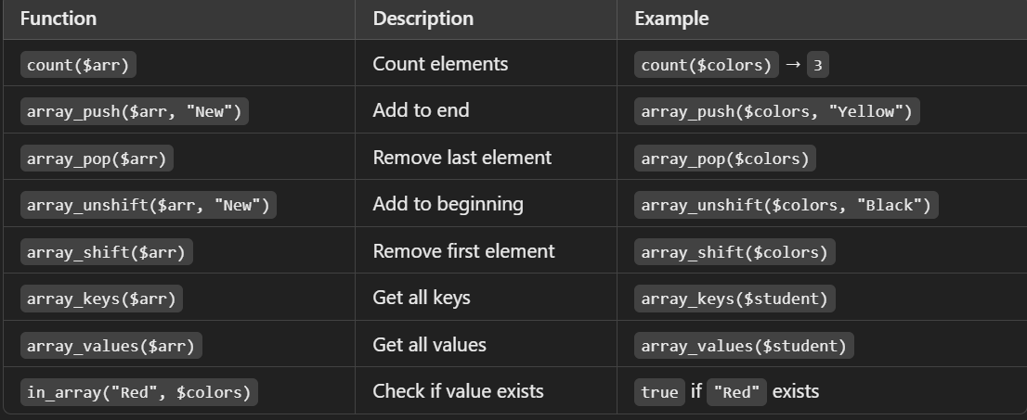
Useful Array Functions

Slide 56
HTML form
HTML forms are used to collect user input and send it to a server for processing. Forms are essential for interactive websites, including login pages, search bars, contact forms, and data submission.
<form action="submit.php" method="POST">
<label for="name">Name:</label>
<input type="text" id="name" name="name" required>
<button type="submit">Submit</button>
</form>

Slide 57
Attributes of <form>
action – Specifies where the form data should be sent (e.g., a PHP or Python file). method – Defines how data is sent to the server:
GET: Sends data in the URL (useful for search forms).
POST: Sends data securely (used for login, sign-up, etc.).

Slide 58
Form Elements
Input Fields (<input>)
The <input> element is used to create various types of form fields.
Common Input Types

Slide 59
<!-- Text Input -->
<input type="text" name="username" placeholder="Enter your name">
<!-- Password Field -->
<input type="password" name="password" placeholder="Enter password">
<!-- Email Input -->
<input type="email" name="email" placeholder="Enter email">
<!-- Number Input -->
<input type="number" name="age" min="1" max="100">
<!-- Phone Number Input -->
<input type="tel" name="phone" pattern="[0-9]{10}" placeholder="Enter 10-digit phone number">
<!-- Date Input -->
<input type="date" name="dob">
<!-- Time Input -->
<input type="time" name="appointment_time">
<!-- Checkbox -->
<input type="checkbox" name="subscribe" value="yes"> Subscribe
<!-- Radio Buttons -->
<input type="radio" name="gender" value="male"> Male
<input type="radio" name="gender" value="female"> Female
<!-- File Upload -->
<input type="file" name="profile_pic">
<!-- Hidden Input -->
<input type="hidden" name="user_id" value="12345">

Slide 60
Labels (<label>)
The <label> element associates a text label with an input field.
<label for="username">Enter Name:</label>
<input type="text" id="username" name="username">
Dropdown (<select> and <option>)
The <select> element creates a dropdown menu
<select name="country">
<option value="us">USA</option>
<option value="uk">UK</option>
<option value="in">India</option>
</select>

Slide 61
Textarea (<textarea>)
Used for multi-line text input.
<textarea name="message" rows="5" cols="30" placeholder="Enter your message"></textarea>
Buttons (<button> and <input type="submit/reset">)
Buttons are used for submitting or resetting form data
<!-- Submit Button -->
<button type="submit">Submit</button>
<!-- Reset Button -->
<button type="reset">Reset</button>
<!-- Another way to submit -->
<input type="submit" value="Submit">

Slide 62
PHP Superglobals
PHP superglobals are built-in variables that are always accessible from anywhere in your script (functions, classes, files) without needing to declare them as global.
List of PHP Superglobals
$_GET – Collects data from URL parameters.
$_POST – Collects data from form submissions.
$_REQUEST – Collects data from both $_GET and $_POST.
$_SERVER – Contains server & execution environment info.
$_FILES – Handles file uploads.
$_SESSION – Stores session variables.
$_COOKIE – Stores cookies for users.
$_ENV – Stores environment variables.
$_GLOBALS – Accesses global variables in a script.

Slide 63
PHP Superglobals: $_SERVER, $_REQUEST, $_POST, $_GET
$_SERVER – Server & Request Information
<?php
echo $_SERVER["PHP_SELF"]; // Current script file name
echo $_SERVER["SERVER_NAME"]; // Server name (e.g., localhost)
echo $_SERVER["HTTP_USER_AGENT"]; // Browser details
echo $_SERVER["REQUEST_METHOD"]; // GET or POST
?>

Slide 64
$_REQUEST – Collects Input from $_GET, $_POST, and $_COOKIE
$_REQUEST stores data from both GET & POST requests.
Useful when you don’t know whether data is coming via GET or POST.

Slide 65
$_POST – Collects Data from Forms Using POST
$_POST is used to collect form data when method="post". It doesn’t show data in the URL, making it more secure than GET.
<form method="post">
Email: <input type="email" name="email">
<input type="submit">
</form>
<?php
if ($_SERVER["REQUEST_METHOD"] == "POST") {
echo "Your email: " . $_POST["email"];
}
?>
Ideal for login forms, registrations, and sensitive data.

Slide 66
$_GET – Collects Data from Forms Using GET
$_GET retrieves form data when method="get". Data is visible in the URL
<form method="get">
Search: <input type="text" name="query">
<input type="submit">
</form>
<?php
if (isset($_GET["query"])) {
echo "You searched for: " . $_GET["query"];
}
?>
Used for search queries, filters, and pagination.

Slide 67
PHP Form Handling
Form handling in PHP allows you to send and process user input safely. You can use the GET or POST method to send form data to a PHP script.
Create an HTML Form
<form action="process.php" method="post">
<label>Name:</label>
<input type="text" name="name">
<input type="submit" value="Submit">
</form>
This sends the name input to process.php using the POST method.

Slide 68
Process Form Data in PHP (process.php)
Now, in process.php, we handle the submitted form data:
<?php
if ($_SERVER["REQUEST_METHOD"] == "POST") {
$name = $_POST["name"]; // Get the input value
echo "Hello, " . htmlspecialchars($name);
}
?>
htmlspecialchars() prevents XSS attacks (security best practice).

Slide 69
Validate Form Data (Avoid Empty Inputs)
Always check if input fields are empty before processing
<?php
if ($_SERVER["REQUEST_METHOD"] == "POST") {
if (empty($_POST["name"])) {
echo "Name is required!";
} else {
$name = htmlspecialchars($_POST["name"]);
echo "Hello, " . $name;
}
}
?>

Slide 70
PHP include vs require
Both include and require are used to import and reuse PHP files, but they behave differently in case of errors.
include – Includes a File (Non-Fatal Error)
If the file is missing, PHP will show a warning but continue execution. Used when the file isn’t critical for the script.
include "header.php"; // If header.php is missing, PHP will show a warning but continue.
echo "Welcome to my website!";

Slide 71
require – Includes a File (Fatal Error)
If the file is missing, PHP will stop execution with a fatal error. Used when the file is necessary for the script
require "config.php"; // If config.php is missing, PHP will stop execution.
echo "This will never execute if config.php is missing!";

Slide 72
PHP File Handling
PHP provides functions to create, read, write, and delete files on the server. File handling is essential for storing logs, user data, and configurations.
Open a File (fopen())
To open a file, use fopen() with mode (read, write, append, etc.).
$file = fopen("data.txt", "r"); // Opens 'data.txt' in read mode
Returns a file handle if successful, or false if the file doesn’t exist.

Slide 73
File Modes:
Mode | Description
"r" | Read-only (file must exist)
"w" | Write (clears existing content or creates new file)
"a" | Append (keeps existing content, adds at the end)
"x" | Creates a new file (fails if file exists)
"r+" | Read & write (file must exist)
"w+" | Read & write (clears existing content)

Slide 74
Read a File (fread())
To read a file's contents, use fread().
$file = fopen("data.txt", "r");
$content = fread($file, filesize("data.txt"));
fclose($file);
echo $content;
Reads entire file and prints content.

Slide 75
Write to a File (fwrite())
To write data to a file, use fwrite()
$file = fopen("data.txt", "w");
fwrite($file, "Hello, PHP!");
fclose($file);
Replaces existing content.
Append Data Instead of Replacing:
$file = fopen("data.txt", "a"); // Open in append mode
fwrite($file, "Adding this text.\n");
fclose($file);
Keeps existing content and adds new text at the end.

Slide 76
Delete a File (unlink())
To delete file
if (file_exists("data.txt")) {
unlink("data.txt");
echo "File deleted!";
} else {
echo "File does not exist!";
}
Removes the file permanently.

Slide 77
PHP Cookies
Cookies are small pieces of data stored in the user's browser and sent to the server with every request. They are commonly used for user authentication, preferences, and tracking.

Slide 78
How to Set a Cookie (setcookie())
Use the setcookie() function to create a cookie
setcookie("username", "JohnDoe", time() + 3600, "/");
60 seconds * 60 minutes * 24 hours = 86400 seconds (1 day)
This creates a cookie named "username" with the value "JohnDoe" that expires in 1 hour
Syntax of setcookie()
setcookie(name, value, expire, path, domain, secure, httponly);

Slide 79
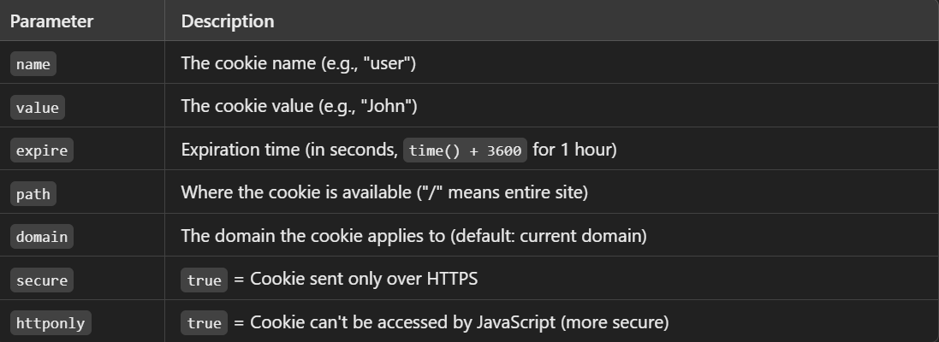

Slide 80
Retrieve a Cookie ($_COOKIE)
if (isset($_COOKIE["username"])) {
echo "Welcome, " . $_COOKIE["username"];
} else {
echo "User not found!";
}
Checks if the cookie exists before using it.

Slide 81
Delete a Cookie
To delete a cookie, set its expiration time in the past.
setcookie("username", "", time() - 3600, "/");
Removes cookie from user browser
$userData = array(
"username" => "JohnDoe",
"email" => "john@example.com",
"role" => "admin"
);
// Convert array to JSON
$cookie_value = json_encode($userData);
// Set the cookie (valid for 30 days)
setcookie("user", $cookie_value, time() + (86400 * 30), "/");

Slide 82
if(isset($_COOKIE["user"])) {
$userData = json_decode($_COOKIE["user"], true); // Convert JSON back to an array
echo "Username: " . $userData["username"];
echo "Email: " . $userData["email"];
echo "Role: " . $userData["role"];
}

Slide 83
PHP Sessions
A session is a way to store user data across multiple pages. Unlike cookies, session data is stored on the server (not in the user's browser), making it more secure.
How to Start a Session (session_start())
Before using sessions, you must start one using session_start(). This must be called at the beginning of the script.
<?php
session_start(); // Start the session
$_SESSION["username"] = "JohnDoe"; // Store data in session
echo "Session started! Username is " . $_SESSION["username"];
?>
✅ Stores "JohnDoe" in a session variable called "username".

Slide 84
Access Session Data
You can access session data on any page after starting the session.
<?php
session_start(); // Start session
echo "Welcome, " . $_SESSION["username"];
?>
Data is persistent across pages as long as the session is active.

Slide 85
Modify or Update Session Data
Simply reassign the session variable:
$_SESSION["username"] = "Alice"; // Update session data
echo "Updated username: " . $_SESSION["username"];

Slide 86
Destroy a Session (session_destroy())
To logout or clear all session data, use session_destroy()
<?php
session_start();
session_destroy(); // Destroy session
echo "Session ended!";
?>
session_destroy() deletes all session data, but session variables may still exist until the page reloads.
✔ To unset a specific session variable, use:
unset($_SESSION["username"]);

Slide 87
Sessions vs. Cookies – What’s the Difference?
Feature | Sessions | Cookies
Stored in | Server | User's Browser
Security | 🔒 More secure | 🔓 Less secure
Lifetime | Expires when browser closes (unless configured) | Can have a set expiration time
Best for | Authentication, user preferences | Tracking, storing non-sensitive data
Use sessions for login systems, user authentication, and secure data storage. ✔ Use cookies for storing small, non-sensitive data like theme settings.

Slide 88
Database
A database is a structured collection of data that allows for storing, managing, and retrieving information efficiently. It helps organize data in a way that makes it easy to access, update, and delete when needed.
Why Use a Database?
✔️ Stores large amounts of data efficiently ✔️ Ensures data consistency and security ✔️ Allows multiple users to access data at the same time ✔️ Reduces redundancy and improves performance

Slide 89
Relational Databases (RDBMS)
Stores data in tables (rows & columns).
Uses SQL (Structured Query Language) to manage data.
Examples: MySQL, PostgreSQL, SQL Server, SQLite, Oracle
An RDBMS is a database system that stores data in tables with relationships between them.
✅ Popular RDBMS Examples:
MySQL
PostgreSQL
SQLite
SQL Server
Oracle

Slide 90
MYSQLI
MySQLi (MySQL Improved) is a PHP extension used to interact with MySQL databases. It is an improved version of the older MySQL extension, offering better security, performance, and support for prepared statements.

